Slide 1
E-COMMERCE ANALYSIS
Unveiling trends in consumer preferences and brand dominance within the e-commerce market.

Slide 2
INTRODUCTION
The purpose of this document is to outline the objectives, methodologies, and expected outcomes of an e-commerce product analysis project. This analysis aims to provide insights into various aspects of product data collected from a major Indian e-commerce platform.
Data Understanding
The dataset comprises information on products available on the ecommerce platform. It includes attributes such as product details, pricing, seller information, and more

Slide 3
OBJECTIVE
This e-commerce product analysis project aims to provide valuable insights into the e-commerce landscape, benefiting both businesses and consumers by informing strategic decisions and optimizations.
Identifying popular product categories and brands.
Analyzing pricing trends and discount strategies.
Understanding seller behavior and performance.
Investigating customer preferences and product satisfaction.
Exploring correlations between various attributes such as price, rating, and brand

Slide 4
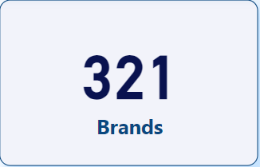
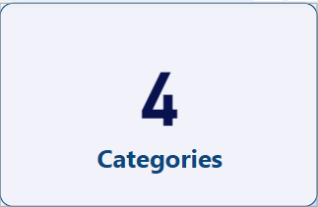
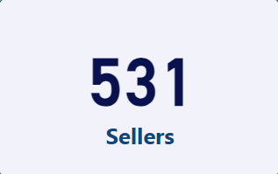
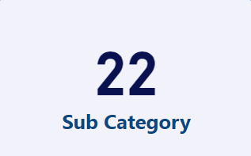
COUNTS OF BRANDS, CATEGORIES & SELLERS

Slide 5
CATEGORIES & THEIR AVERAGE RATING
Category Analysis:
Bags, Wallets & Belts: Highest average rating (4.13), indicating strong customer satisfaction. Focus on showcasing diverse, high-quality products.
Footwear: Significant category with a slightly lower average rating (3.88). Consider enhancing product quality and offering attractive discounts to boost satisfaction.
Clothing and Accessories: Popular but with a lower average rating (3.63). Improve product quality and variety to increase engagement.
Toys: Potential for growth, but the average rating (3.60) suggests room for improvement in product quality and variety.
Website Recommendations:
Optimize User Experience: Streamline navigation and improve search functionality.
Personalization: Implement personalized product recommendations.
Customer Reviews: Encourage and prominently display customer reviews to build trust.
Customer’s Point of view (guess):
Explore Diverse Categories: Discover a wide range of products.
Prioritize Quality: Emphasize product quality over price.
Engage with Feedback: Provide feedback on purchased items.

Slide 6
Category selling & actual price & their discounts
Insights:
Clothing and Accessories: The category offers a discount of 52%, with the selling price at ₹724.56 compared to the actual price of ₹1484.21, potentially attracting budget-conscious shoppers.
Footwear: With a significant discount of 63%, footwear products are priced at ₹501.23 compared to ₹948.45, offering customers substantial savings while maintaining product quality.
Bags, Wallets & Belts: Customers can enjoy a discount of 60% on items in this category, priced at ₹258.51 compared to ₹715.37, making it an attractive option for those seeking affordable accessories.
Toys: The category provides a discount of 62%, offering products at ₹189 compared to ₹499, appealing to both children and parents looking for value-for-money options.
Recommendations:
Promotional Campaigns: Highlight the significant discounts across categories in marketing campaigns to attract price-sensitive customers.
Customer Engagement: Encourage customer feedback to ensure that discounted products maintain quality standards, enhancing overall customer satisfaction.
Competitive Pricing: Continuously monitor competitor pricing strategies to adjust discounts accordingly, maintaining competitiveness in the market.

Slide 7
TOP 10 SELLERS
INSIGHTS & RECOMMENDATIONS:
Pricing and Performance: Sellers with higher average ratings often offer competitive prices, indicating a correlation between pricing and customer satisfaction.
Customer Preference: Products with higher ratings tend to attract more customers, suggesting the importance of quality and customer experience.
Seller Strategy: Analyze pricing strategies of high-rated sellers to understand how they balance price and quality to attract and retain customers.
Customer Feedback: Encourage customers to provide feedback to improve product quality and overall satisfaction, which can positively impact seller performance.
Competitive Analysis: Monitor pricing trends and ratings of competitors to identify opportunities for strategic pricing adjustments and product enhancements.

Slide 8
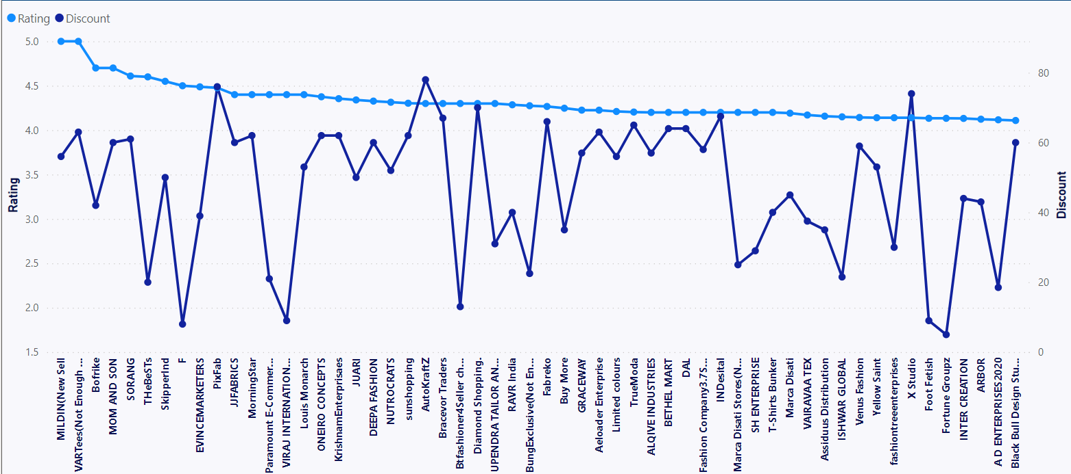
SELLERS THEIR RATINGS AND DISCOUNTS
1. Highly Rated Sellers: VARTees and MILDIN showcase exceptional ratings, indicating superior customer satisfaction, while maintaining discounts of 63% and 56%, respectively.
2. Discount Strategies: PixFab's substantial discount of 76% highlights an effective strategy to attract price-conscious customers, influencing purchasing decisions.
3. Competitive Pricing and Ratings: Paramount E-Commerce3.4 and VIRAJ INTERNATIONAL strike a balance with a 4.4 rating, coupled with moderate discounts, reflecting competitive pricing strategies.
4. Consistency in Customer Satisfaction: ONEIRO CONCEPTS and DEEPA FASHION maintain high ratings above 4.3, alongside consistent discounts, signaling a commitment to product quality and customer satisfaction.

Slide 9
TOP 10 BRANDS
Insights:
REEBOK CLASSIC: Priced at ₹2004.41 compared to an actual price of ₹3474.96, with a rating of 4.16, offering a balance of quality and affordability for customers.
Bofri: Providing products at ₹1264.50 compared to ₹2424.00, with a rating of 4.15, making it an attractive option for budget-conscious consumers.
U.S. Polo Association: With a rating of 4.11, the brand offers products at ₹1047.10, providing customers with quality items at an affordable price point.
INTER CREATI: Offering a discount, the brand sells products at ₹910.07 compared to ₹1641.14, with a rating of 4.13, appealing to customers seeking value for money.
Wet Off Ho: Priced at ₹870.80 compared to ₹2870.20, with a rating of 4.14, showcasing a significant discount and favorable customer ratings.
Recommendations:
Promotional Strategies: Highlight discounted products from popular brands like REEBOK CLASSI and Bofri in marketing campaigns to attract more customers.
Quality Assurance: Ensure that discounted products maintain high quality standards to uphold customer satisfaction and brand reputation.
Competitive Pricing: Continuously monitor competitor pricing strategies to adjust discounts and remain competitive in the market.
Customer Engagement: Encourage customer feedback to understand their preferences better and tailor product offerings accordingly.

Slide 10
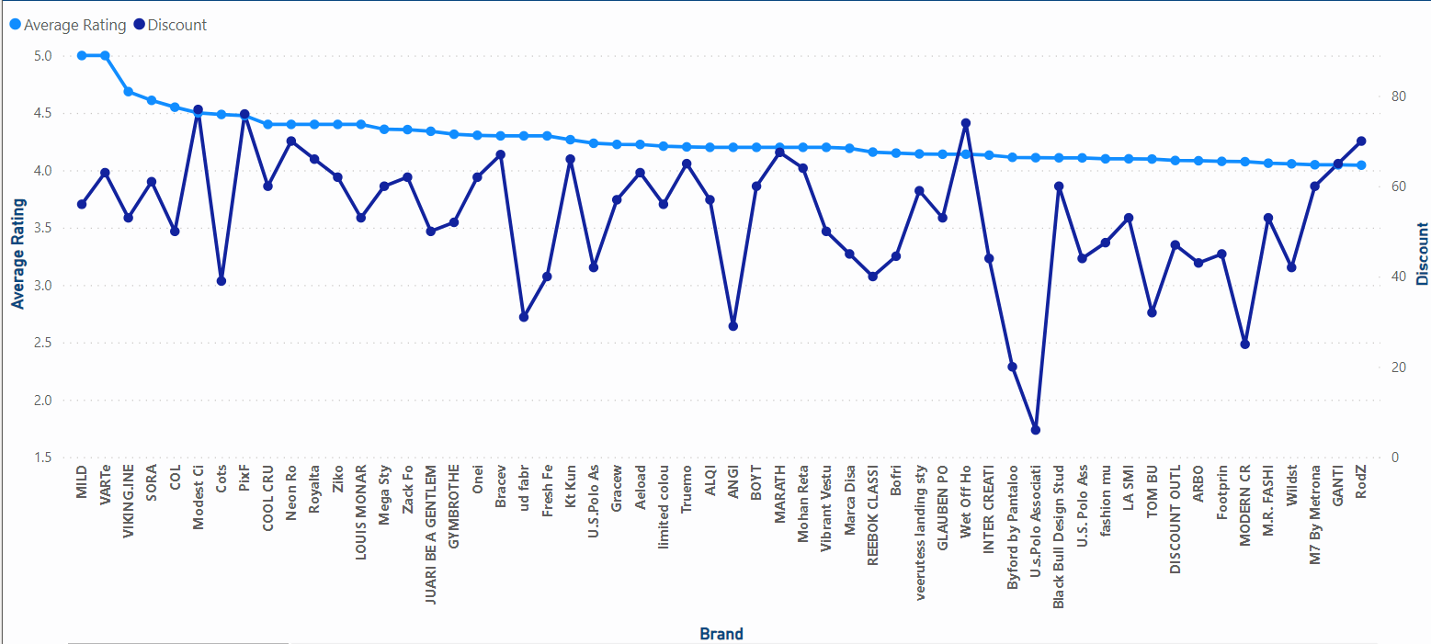
BRANDS THEIR RATINGS AND DISCOUNTS
INSIGHTS:
Highly Rated Brands: MILD and VARTe boast perfect ratings of 5, indicating exceptional customer satisfaction, while brands like VIKING.INE and SORA maintain strong ratings above 4.5.
Discount Strategies: Modest Ci and PixF offer substantial discounts of 77% and 76% respectively, attracting price-conscious customers without compromising on quality, while brands like NEON RO and ROYALTA also provide significant discounts of 70% and 66%.
Diverse Rating Spectrum: Brands like BOYT and MARATH consistently maintain ratings of 4.2, reflecting steady customer satisfaction, while others like FASHION WOU and FOOT F receive lower ratings despite offering discounts, suggesting potential quality concerns.
Variety in Discount-Rating Correlation: Some brands like Ziko and Bracev achieve high ratings alongside moderate discounts, while others like Byford by Pantaloo and U.S. Polo Associati present lower ratings despite offering lower discounts, highlighting areas for improvement in discount strategies and product quality assurance.

Slide 11

PROJECT DONE BY
SHANMUGAGOUTHAMAN KARUPPIAH
DTM 10

